Slide 1
Health Insurance Prediction Cost in USA, using Machine Learning
O.J. Ndebbio
Project-3; Rice University Data_ANALYTICS BOOTCAMP, July 2020

Slide 2
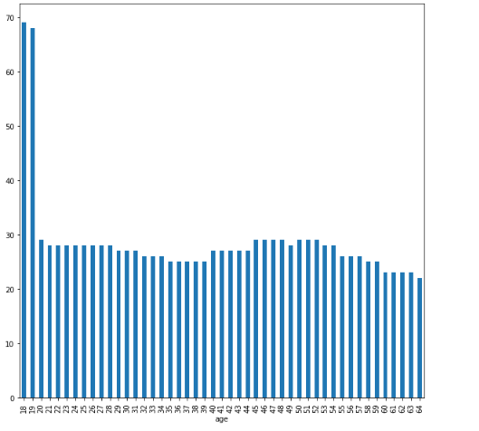
Age vs charges
From this visual we can see that ages 18 and 19 do spend more on insurance than any other age group

Slide 3
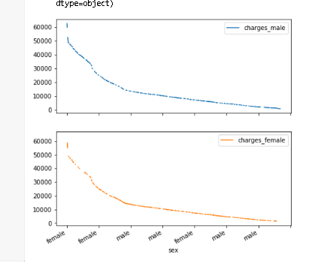
Gender vs charges
From this visual we can suggest that charges of insurance has no effect on gender, it is unbiased

Slide 4
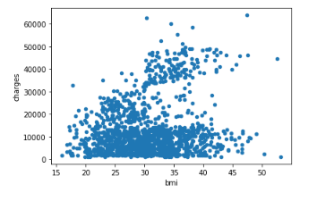
Bmi vs charges
From this visual we can suggest that as BMI increases we can see increase in charges

Slide 5
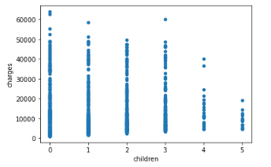
Children vs charges
From this visual we can suggest that as People with no children do spend more on charges , rather those people that has 4 5 children,

Slide 6
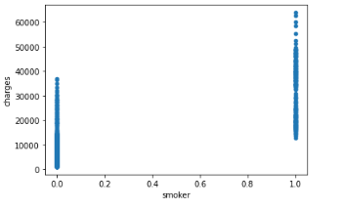
Smoker vs charges
From this visual we can suggest that in obvious real-world scenario, that non-smokers do spend less on insurance than smokers

Slide 7
Smoker vs charges
From this visual we can suggest that obvious real world scenario that non-smokers do spend less on insurance than smokers

Slide 8
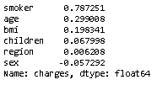
Correlation of each variable with charges
Smokers columns is highest when correlated with money spent on insurance

Slide 9
Problem: predict the charges based on other columns
Machine Learning Summary
ML model | Hypermater Tuned | RMSE score
Decision tree Regressor | No | 6773.849859736164
Decision Tree Regressor | Yes | 4903.127141676565
Gradient Boosting Tree | Yes | 7027.151092343622
Hyperparameter tuned Decision tree regressor outperformed every other algorithm.

